Slide 1

US Traffic Accidents in 2019:
A Data Exploration
Presented by:
Sue Young and Tricia Miller

Slide 2
The DataSet
Initial Dataset
The data was pulled from Kaggle.com.
It spanned from 2016-2019 and contained over 3 million record
Building a Manageable Dataset
Filtered to include 2019
Removed unwanted columns
Removed null responses and NAs
Final Data Analysis Focus
Individual States
Hour Accidents occurred
Day of the Week
Top 10 dates accidents occurred
Overall view of the total accidents across the US

Slide 3
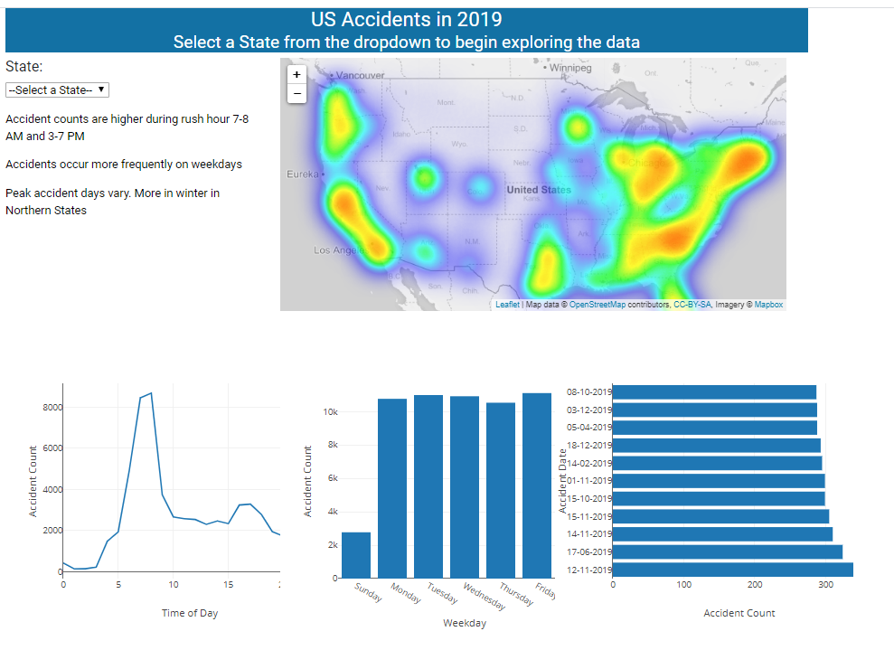
Data Visualization

Slide 4
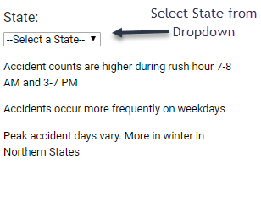
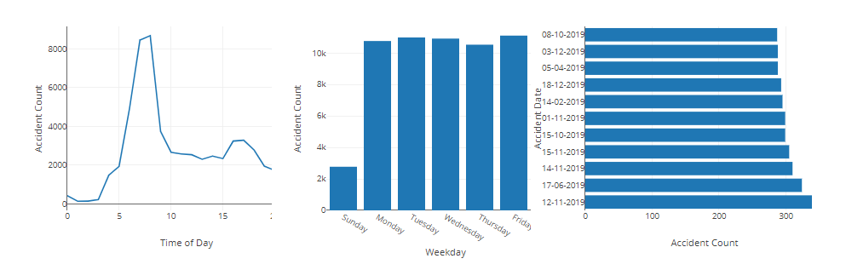
How it works

Slide 5
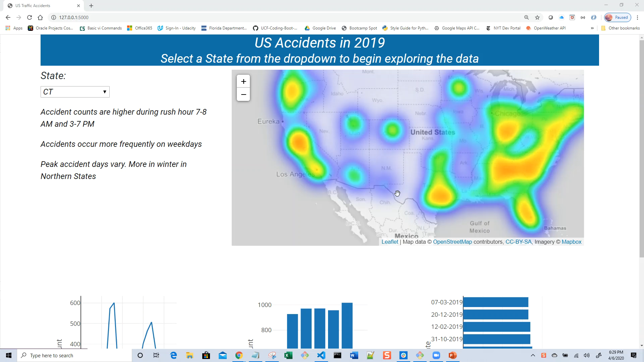
Demonstration

Slide 6
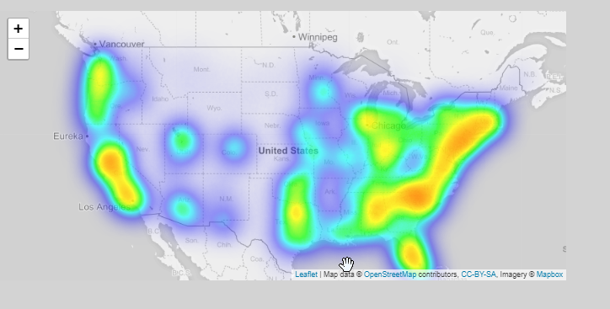
Data Analysis: Overall
As expected the more densely populated areas have the high number of accidents

Slide 7
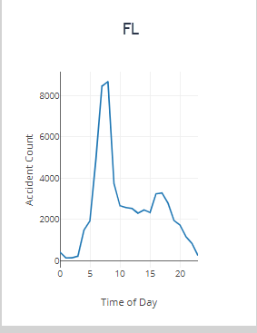
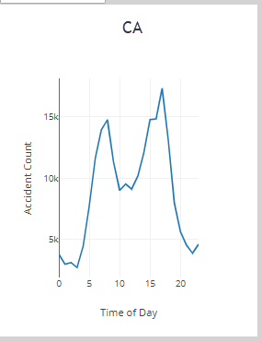
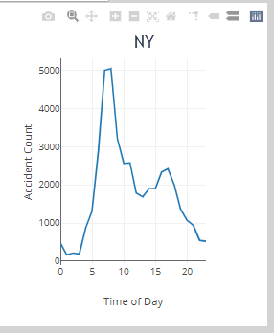
Data Analysis: Accidents by Time of Day
Looked at three State: CA, FL, NY
Most occurred during rush hour
FL and NY similar. Both had more accidents in the morning (rush hour)
CA stayed about the same between morning and evening with evening peaking a little higher

Slide 8
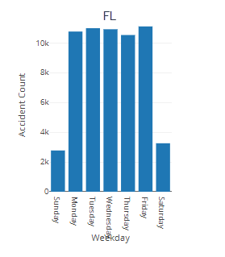
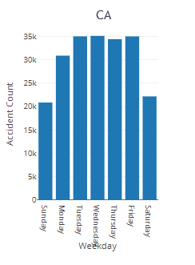
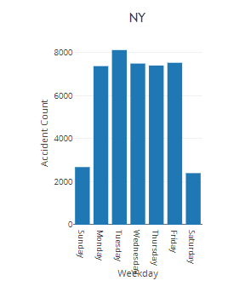
Data Analysis: Accidents by Day of the week
Looked at three State: CA, FL, NY
Most occurred Monday through Friday
FL and NY similar.
CA had significantly more on the weekends

Slide 9
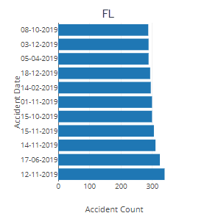
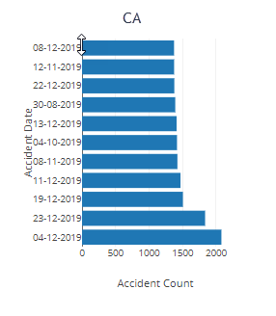
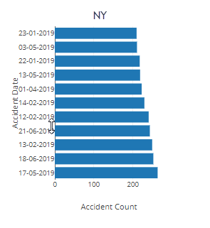
Data Analysis: Top 10 dates accidents occur
Looked at three State: CA, FL, NY
FL more in the winter months October-December
NY no real pattern
CA winter months (November through December

Slide 10

Under the hood
Python
SQLite
Jquery
Bootstrap
D3
Plotly
Leaflet
Datastic Style

Slide 11

Testing
Row counts matched the raw data
Filtered sets were validated against the raw data
Plots were validated at select sample data points

Slide 12

Next steps
Performance optimization
Expand data to comparison by country
Analysis on weather and accidents
Aesthetics
Analysis on accidents per capita

Slide 13
Questions

